Slide 1
Project Presentation of CO-OP Project at Industry (Module-2) (22CS421)
On
Emotion AI: Computational Techniques for Automatic
Emotion Recognition
Sakshi Rana
2210990769
Supervised By
Dr. Gurpreet Singh
Department of Computer Science and Engineering,
Chitkara University, Punjab

Slide 2
Introduction
Emotion recognition is a critical component of modern intelligent systems that enables machines to understand and interpret human emotional states. It plays a significant role in enhancing human–computer interaction by allowing systems to respond in a more natural and context-aware manner. With the rapid advancement of artificial intelligence and deep learning, emotion-aware systems are increasingly being used in applications such as healthcare monitoring, virtual assistants, and smart education platforms. However, accurately identifying human emotions remains a complex challenge due to variability in expressions and contextual dependencies.
2

Slide 3
Problem Statement
Most existing emotion recognition approaches are based on unimodal systems, where only one type of data such as facial expressions, speech signals, or textual input is considered. These approaches suffer from several limitations:
Sensitivity to noise and environmental variations
Lack of contextual understanding
Inconsistent performance across different users
For example, a person may smile while feeling stressed, or speech tone may not always reflect actual emotions. As a result, unimodal systems fail to capture the complete emotional state, leading to reduced accuracy in real-world applications.
3

Slide 4
Proposed Approach
To overcome the limitations of unimodal systems, a multimodal emotion recognition framework is proposed that integrates facial, speech, and textual data. The key idea is that different modalities capture different aspects of human emotion, and combining them provides a more comprehensive understanding.
Facial expressions capture visual emotional cues
Speech signals provide tonal and acoustic information
Textual data reflects semantic and contextual meaning
By leveraging deep learning techniques, the system is capable of extracting meaningful features from each modality and combining them to improve overall performance and robustness.
4

Slide 5
System Architecture
The proposed system follows a structured pipeline consisting of multiple stages. Initially, data from facial images, speech signals, and textual inputs is collected and preprocessed to remove noise and standardize the input format. Each modality is then processed independently using specialized deep learning models.
The outputs generated by these models are passed to an adaptive fusion layer, where they are combined to produce the final emotion prediction. This architecture ensures that the system does not rely on a single modality and can perform effectively even when one of the inputs is unreliable.
5

Slide 6
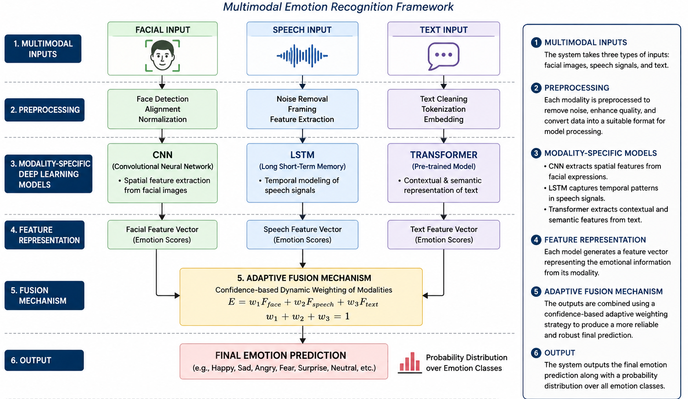
System Architecture
6

Slide 7
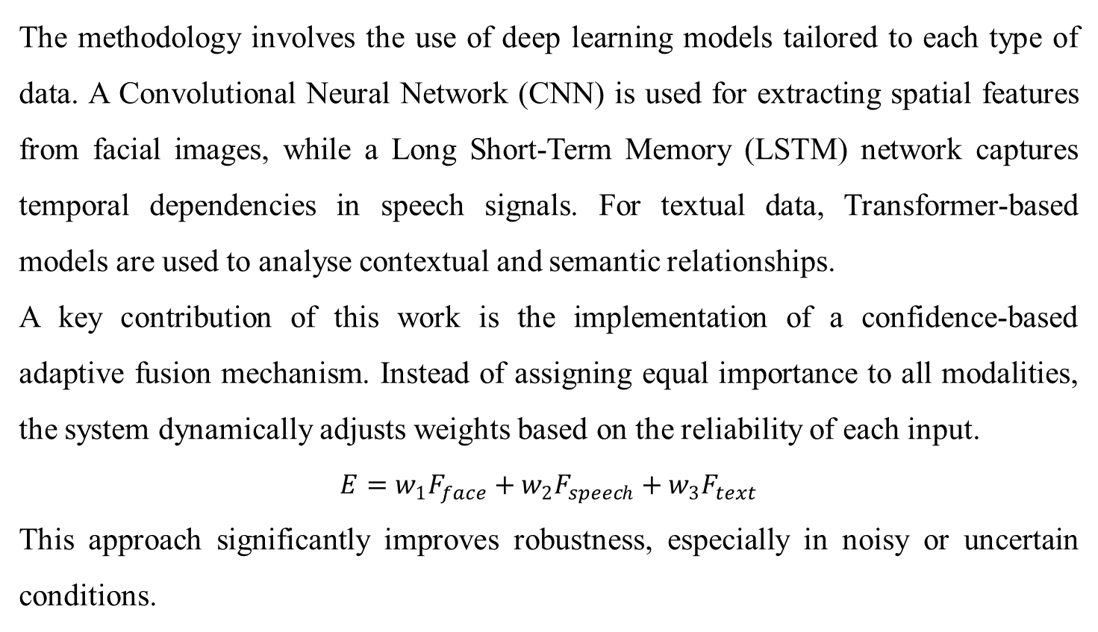
Methodology
The methodology involves the use of deep learning models tailored to each type of data. A Convolutional Neural Network (CNN) is used for extracting spatial features from facial images, while a Long Short-Term Memory (LSTM) network captures temporal dependencies in speech signals. For textual data, Transformer-based models are used to analyse contextual and semantic relationships.
A key contribution of this work is the implementation of a confidence-based adaptive fusion mechanism. Instead of assigning equal importance to all modalities, the system dynamically adjusts weights based on the reliability of each input.
$$E=w_{1}F_{face}+w_{2}F_{speech}+w_{3}F_{text}$$
This approach significantly improves robustness, especially in noisy or uncertain conditions.
7

Slide 8
Experimental Results and Analysis
The performance of the proposed system was evaluated using benchmark datasets under different conditions. The results indicate that unimodal models achieve moderate accuracy, while the multimodal approach significantly improves performance.
Facial model accuracy: 78%
Speech model accuracy: 75%
Text model accuracy: 80%
Multimodal system accuracy: >90%
The overall improvement of approximately 15–20% demonstrates the effectiveness of combining multiple modalities. The system also shows better performance in noisy environments, highlighting the importance of adaptive fusion in handling real-world scenarios.
8

Slide 9
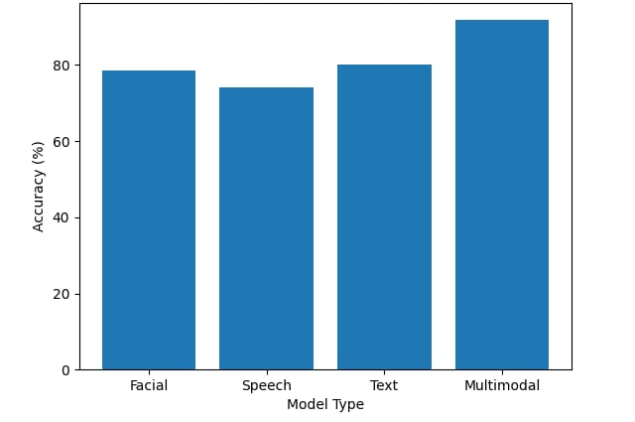
Experimental Results and Analysis
Multimodal approach significantly outperforms unimodal systems
9

Slide 10
Conclusion
The proposed multimodal emotion recognition framework effectively addresses the limitations of traditional unimodal systems by integrating multiple sources of data. The use of deep learning models enables efficient feature extraction, while the adaptive fusion mechanism enhances accuracy and reliability.
The system demonstrates significant improvement in performance and is suitable for real-world applications such as healthcare monitoring, intelligent tutoring systems, and virtual assistants. Future work can focus on optimizing computational efficiency, expanding datasets, and addressing ethical and privacy concerns associated with emotion-aware systems.
10

Slide 11
Future Scope
The proposed multimodal emotion recognition system can be further enhanced by incorporating additional modalities such as physiological signals (e.g., EEG, heart rate) to improve accuracy and reliability. Future research can focus on real-time emotion detection systems for applications in healthcare monitoring and human–robot interaction.
Moreover, the use of advanced deep learning architectures and larger, more diverse datasets can help improve model generalization. Addressing privacy and ethical concerns related to emotion data collection will also be an important area of future work.
Additionally, optimizing the computational efficiency of the system can make it more suitable for deployment on mobile and edge devices.
11

Slide 12
Thank You
12

